Slide 2
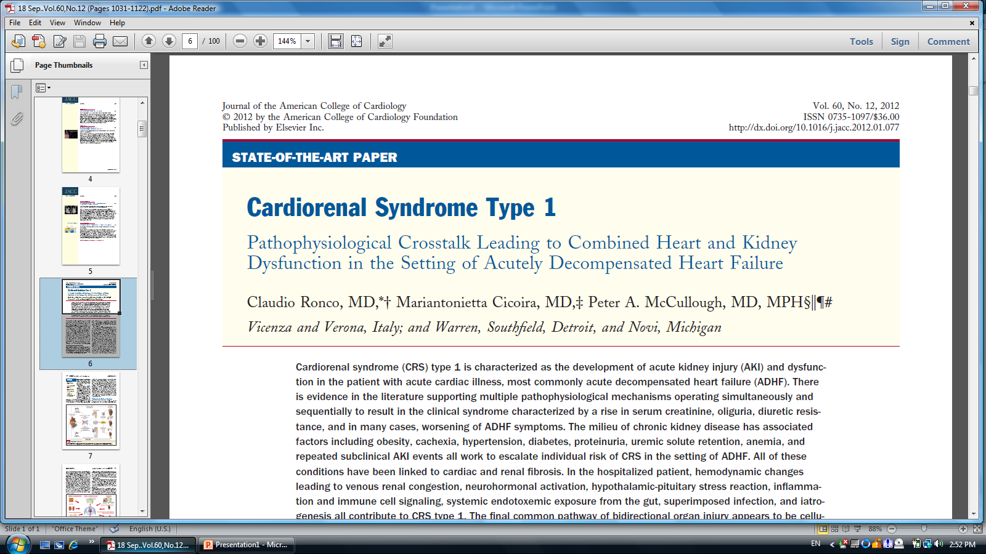

Slide 3
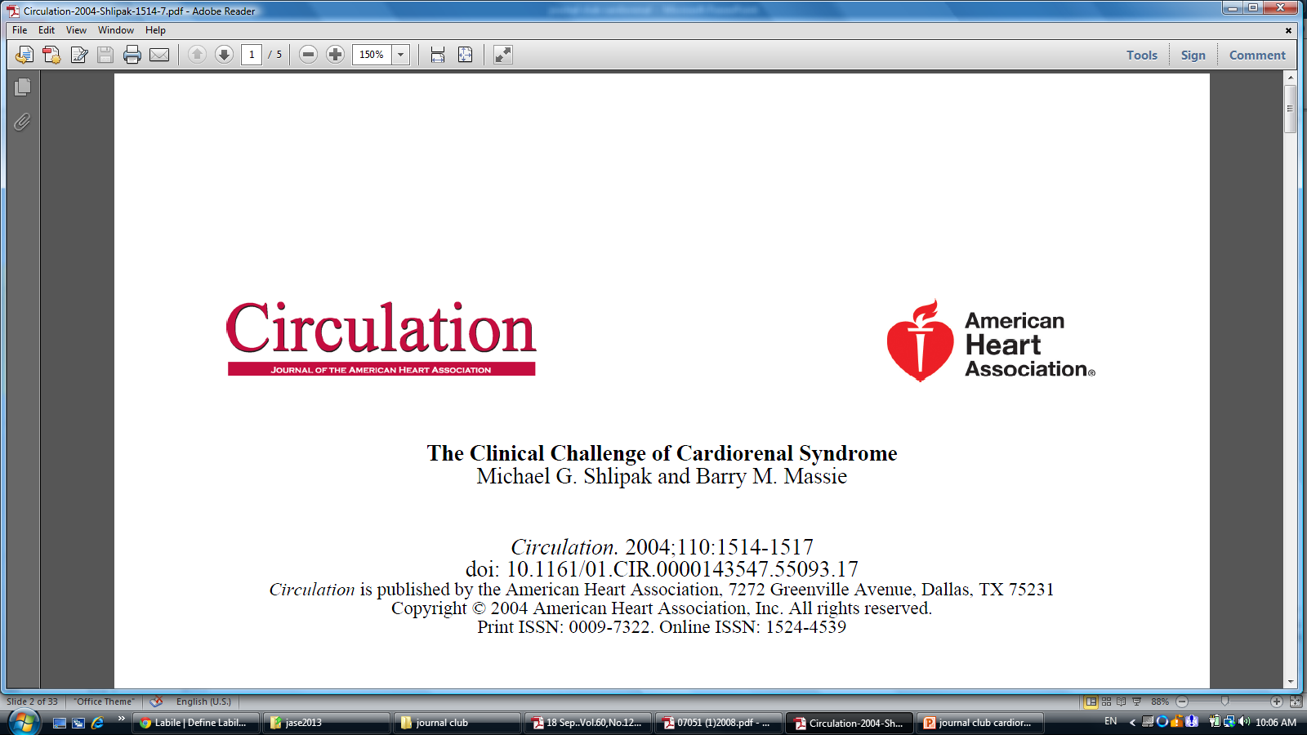
This risk becomes
evident even at serum creatinine levels 1.3 mg/dL
and estimated creatinine clearance values 60 to 70 mL/min

Slide 4
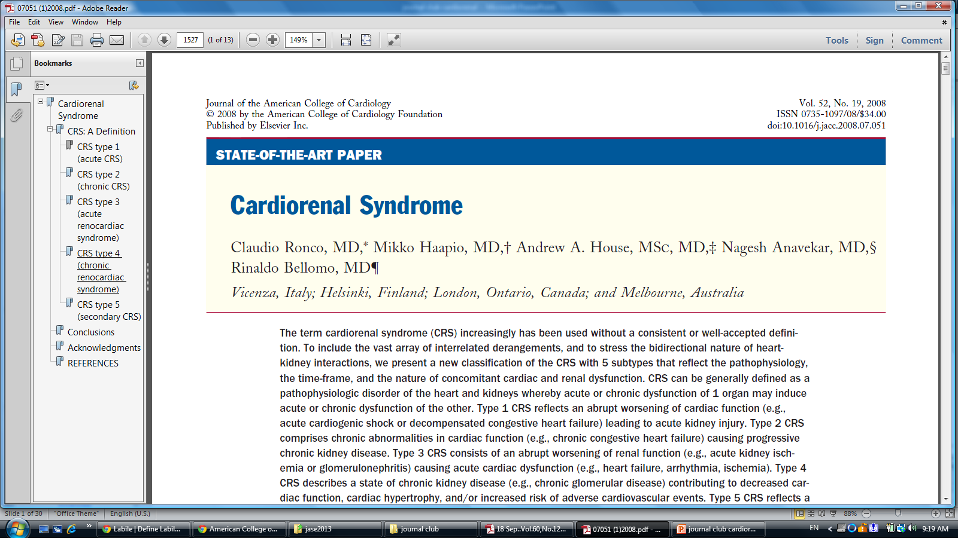

Slide 10
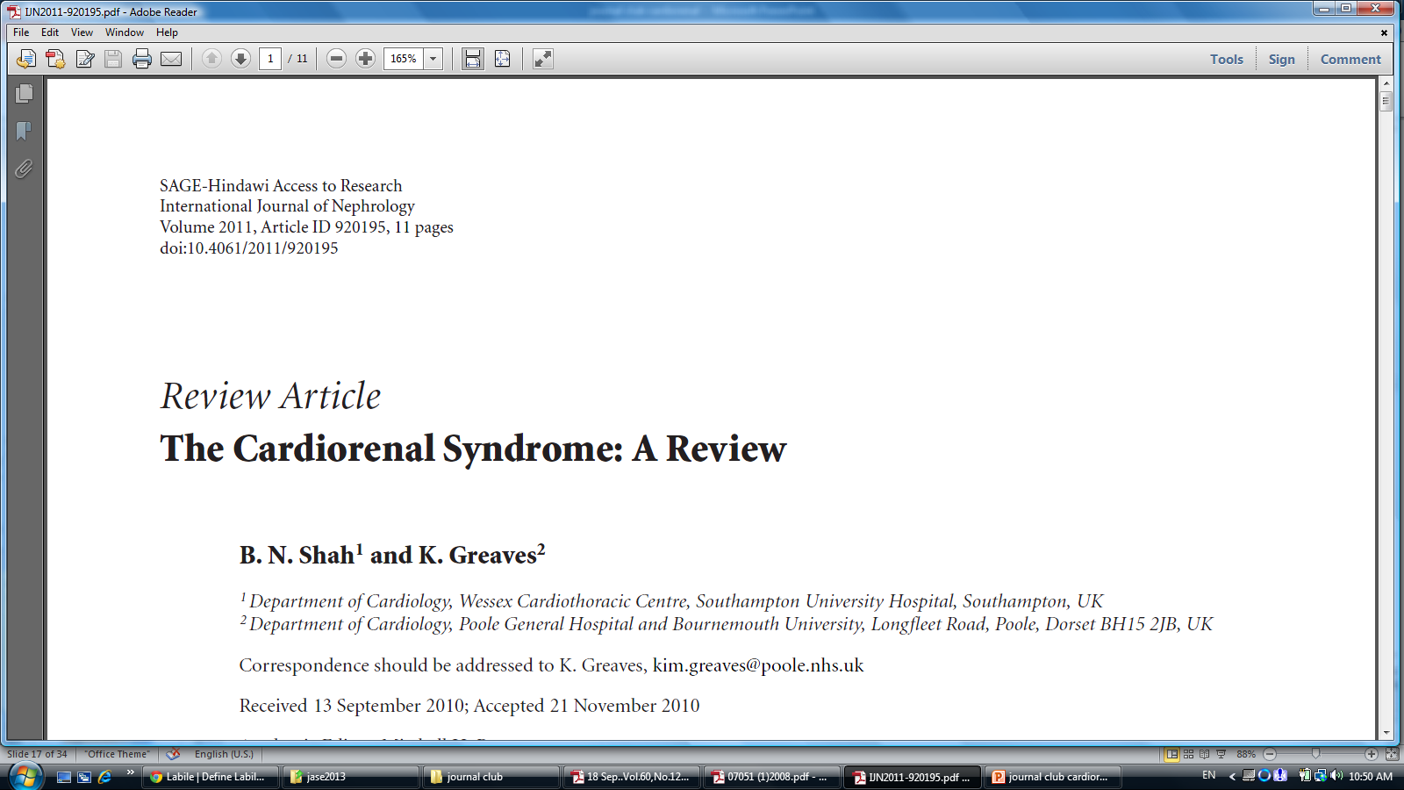

Slide 11
CRS Classification
Type 1:abrupt worsening of cardiac function (e.g.,acute cardiogenic shock or decompensated congestive heart failure) leading to acute kidney injury.
Type 2: CRS comprises chronic abnormalities in cardiac function (e.g., chronic congestive heart failure) causing progressive chronic kidney disease.
Type 3: Abrupt worsening of renal function (e.g., acute kidney ischemia or glomerulonephritis) causing acute cardiac dysfunction (e.g., heart failure, arrhythmia, ischemia).
Type 4:a state of chronic kidney disease (e.g., chronic glomerular disease) contributing to decreased cardiac function, cardiac hypertrophy, and/or increased risk of adverse cardiovascular events.
Type 5:systemic condition (e.g., sepsis) causing both cardiac and renal dysfunction

Slide 12
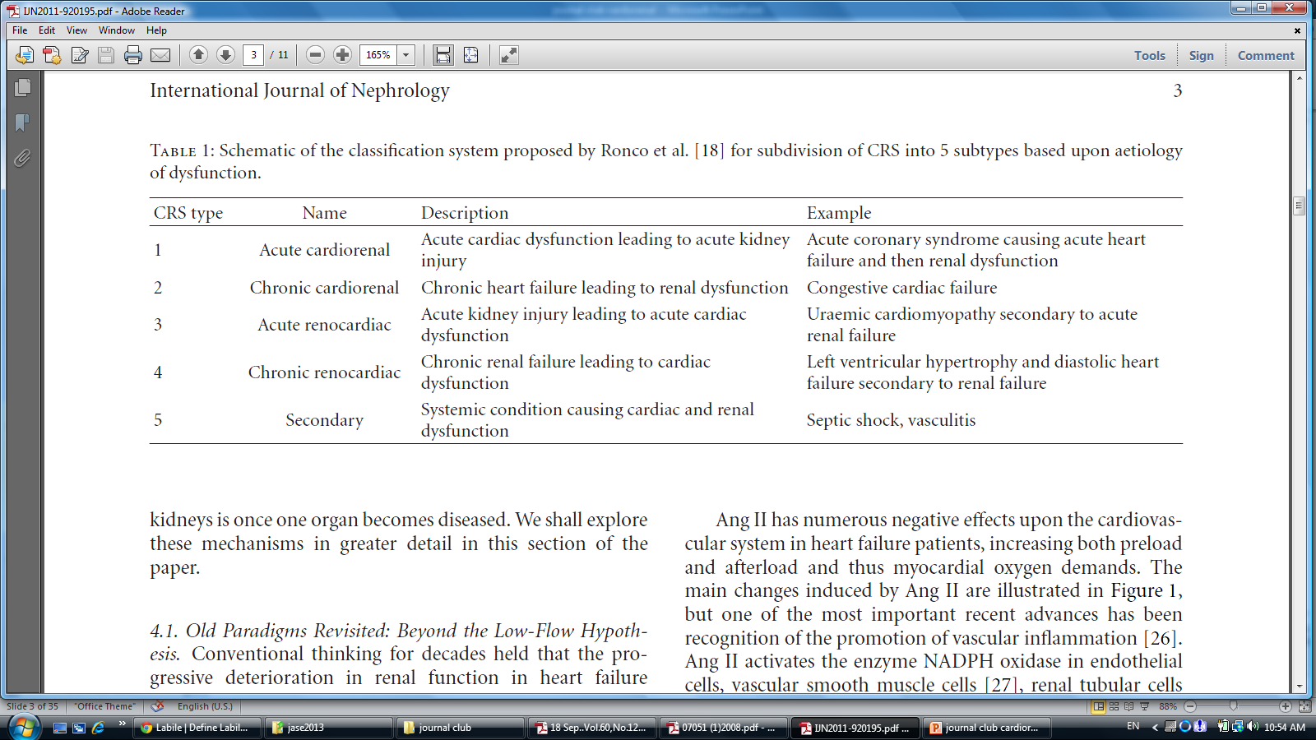

Slide 13
4 Subtypes Of CRS Type 1
De novo cardiac injury →De novo Kidney injury(25%,and premorbid kidney in 60%)
De novo cardiac injury →Acute on chronic kidney injury
Acute on chronic cardiac decompensating → De novo kidney injury
Acute on chronic cardiac decompensating→ Acute on chronic kidney injury

Slide 14
AKI is an independent risk factor for 1-year mortality in ADHF patients, including patients with ST-segment elevation myocardial infarction who develop signs and symptoms of HF or have a reduced left ventricular ejection fraction.

Slide 16
Predisposition for Cardio renal Syndromes
Obesity and cardio metabolic changes
Cachexia
Hypertension and diabetes
Proteinuria
Uremic solute retention
Anemia
Repeated episodes of subclinical AKI

Slide 17
Role Of Obesity
Cytokines
LV remodeling
Hyper filtration of kidney →CKD

Slide 18
Cachexia
Sarcopenia
Pro-inflammatory factors
Death ,Infection

Slide 19
Proteinuria
↑Workload of proximal tubules
Apoptosis of tubules→ Nephron Loss → KCD
Albuminuria in the general population is predictive
of the development of HF, and in those with established HF, it is present in 30% and associated with hospitalization and mortality . Microalbuminuria, thus, is a risk marker
for cardiovascular disease and CKD, and is probably a pathogenic factor in the progression of CKD.

Slide 20
Uremic solute retention
uremia causes myocyte dysfunction manifested by impaired
movement of calcium in the cytosol leading to impaired
contraction of myocyte elements . In addition, uremia
directly contributes to accelerated fibrosis and adverse
cardiac remodeling after myocardial infarction.
Hyperuricemia
is associated with uremia and has been associated with
atherosclerosis and cardiovascular death in multiple studies.

Slide 21
Pathogenesis of anemia in HF
Hemodilution due to water retention,
Blockade of normal iron transport, inflammation/cytokine induce erythropoietin deficiency ,
and tissue resistance,
malnutrition, cachexia, vitamin deficiency, all amplified in the presence of pre-existing CKD .

Slide 22
Reduced responsiveness to erythropoietin in patients with HF and CKD has been associated with high levels of hepcidin-25, a key regulator controlling iron intestinal absorption and distribution throughout the body . High levels of cytokines induce the iron-utilization defect by increasing hepcidin-25 production from the liver, which blocks the ferroportin receptor and impairs gastrointestinal iron absorption and iron release from macrophage and hepatocyte stores.

Slide 23
Repeated episodes of subclinical AKI
It is highly probable that some individuals undergo repeated episodes of either subclinical or unrecognized episodes of AKI over the course of a lifetime. With each episode, there is injury to nephron units, with partial recovery of some and permanent death to others. Because of the kidney’s ability to alter both blood flow and filtration, the clinician would not be able to detect these events with the measurement of serum creatinine.

Slide 25
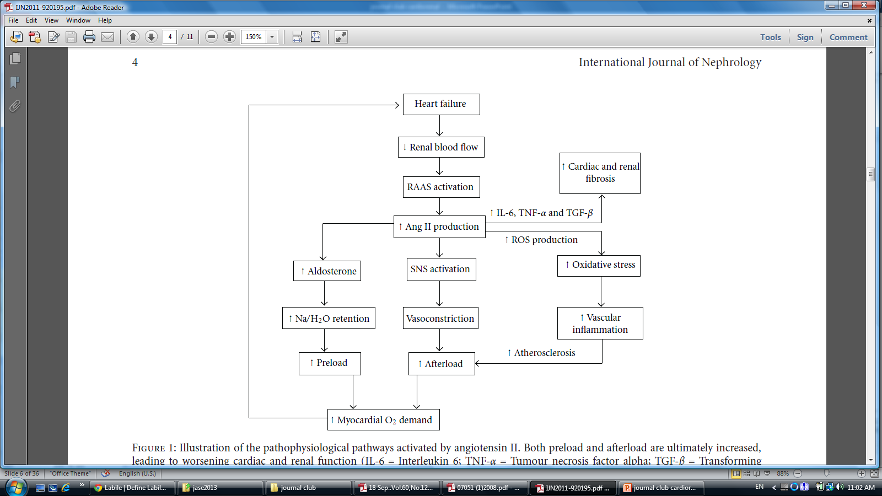

Slide 27
Cardiac and Renal Fibrosis
CRS→ Ag II ,Aldosterone
↓
Macrophages
↓
Galactin 3
↓
Fibrosis

Slide 28
The Acute Pathways of CRS Type 1
Hemodynamics and congestion
Neurohormonal activation
Hypothalamic-pituitary stress reaction

Slide 29
Hemodynamics and congestion
In the ADHERE registry, registry, 50% of patients
who were admitted to the hospital had a systolic blood pressure of 140 mm Hg or higher, and only 2% had a systolic blood pressure of 90 mm Hg .
↑Afterload, ↑Remodeling ,Functional MR ,↑Filling Pressure ,↑LAP
Congestion

Slide 30
Neurohormonal activation
Early HF Renin Ag II
Thirst Central Neural Center
Vasoconstriction
↑Venous Tone
+Trophic Effect On myocardium , Renal Tubules
+ Aldosterone

Slide 31
Hypothalamic-pituitary stress reaction
Any stressor that activates the hypothalamus pituitary-adrenal axis leads to an increase in concentrations of the adrenal stress hormone cortisol.
One of the major hypothalamic stress hormones, which are stimulated by different stressors including osmotic and non-osmotic stimuli (cytokines), is arginine vasopressin.

Slide 32
Hypothalamic-pituitary stress reaction
Copeptin levels have been found to closely
mirror the production of arginine vasopressin
proposed as a prognostic marker in acute illness.
Copeptin is elevated in several scenarios leading to CR S, including sepsis, pneumonia, lower respiratory tract infections, stroke,
and other acute illnesses.

Slide 33
AVP
A1a :↑Systemic vascular resistance
A2 :↑Water reabsorption , Hyponatremia
AVP :↑Transport of Urea in collecting tubules → ↑BUN

Slide 34
*It is important to recognize that hyponatremia is a relatively late sign of arginine vasopressin overstimulation, and thus, earlier modulation of this system is an important consideration in treatment.
The arterial under filling
*occurs secondary to a decrease in cardiac output in
low-output HF and arterial vasodilatation in high-output
HF, both of which decrease the inhibitory effect of the
arterial stretch baroreceptors on the sympathetic and
RAAS. Thus, a vicious cycle of worsening HF and edema
formation occurs.

Slide 35
Inflammation and immune cell signaling
1) cells;
2) cytokines;
3) antibodies;
4) complement.
Excessive elevations of cytokines and markers of inflammation documented in ADHF .
inflammation interferes with reabsorption of interstitial or alveolar edema and thus leads to pulmonary fluid overload despite no increase in total body fluid .

Slide 36
The role of the gut and endotoxemia
Underperfusion of the intestine
Hematogenous release of endotoxin
progression of HF and CRS type 1, particularly in patients with cachexia

Slide 37
Endotoxins
Altering myocardial intracellular calcium, reducing mitochondrial activity, causing imbalance of autonomic nerve activity, thus affecting many other organs, including the
kidneys .
Disturbed mitochondrial respiration, reduction in
resting membrane potential, Na/K gradient and impaired substrate metabolism, increased expression of metalloproteinases………..

Slide 38
Superimposed infection and Iatrogenesis

Slide 41
Although loop diuretics
provide prompt diuresis and relief of congestive symptoms,
they provoke a marked activation of the sympathetic and
RAAS, resulting in renovascular reflexes and sodium retention,
and thus are considered a primary precipitant of CRS.
This places the patient with ADHF at risk for CRS in a narrow therapeutic management window with respect to fluid balance and blood pressure .

Slide 42
Felker et a, in a small randomized trial of ADHF, demonstrated that higher doses and continuous infusions of furosemide resulted in more patients developing AKI (rise in creatine 0.3 mg/dl) with no improvement in hospitalization or death.

Slide 43
Final Common Pathway of Injury
Oxidative Stress

Slide 44
The most widely recognized chemical reactions generating reactive oxygen species are the Haber-Weiss and Fenton
equations.
These equations require oxygen, water, hydrogen, and a
metal catalyst in the form of iron, copper, and so on.

Slide 45
Iron is the most abundant metal element in cells, it is
believed that labile iron is the major stimulus for oxidative
stress that results in tissue injury.

Slide 46
Failure of Counter-Regulatory Mechanisms In response to wall tension, the cardiomyocyte produces large quantities of natriuretic peptides that work to reduce wall tension, vasodilate, and promote natriuresis and diuresis. Ischemia is also recognized as a stimulus for natriuretic peptide production. Natriuretic peptides, working via natriuretic peptide receptors in the glomerulus and the renal tubules, activate cCMP and reduce sodium reabsorption.

Slide 47
However, this counterregulatory
set of functions appears to be overwhelmed in
CRS type 1, and thus, the patient worsens clinically and
develops oliguria in the setting of markedly elevated levels of
natriuretic peptides.

Slide 48
Take Home Message
The depth of knowledge and complexity of care necessary to offer best therapy to these patients
Demands multidisciplinary
approach, combining the expertise
of cardiology, nephrology, and
critical care.

